Slide 1

Infamous Hounds
Defensive Security Project
Members:
Francisco Munoz
Khoi Ha
Paul Richardson
Colin O’Donoghue

Slide 2
Table of Contents
This document contains the following resources:
Monitoring Environment
Attack Analysis
Project Summary & Future Mitigations

Slide 3

Monitoring Environment
‹#›

Slide 4
Scenario
The Infamous Hounds were tasked with assisting Virtual Space Industries (VSI) with monitoring log files to determine if there has been suspicious activity within the company’s servers. A competitor, ‘JobeCorp’, has been suspected of infiltration and are pinned as a possible culprit to the alleged suspicious activity. We have worked tirelessly to aid VSI in their investigation, as we needed to analyze two servers; one being Windows and the other being Apache.
Together, after carefully sorting through the data, we have developed baselines, created reports and alerts, and provided mitigations for future reference to ensure the security of these servers moving forward. Our findings and report are included within the following presentation.

Slide 5
Splunk Add-on for Microsoft Windows
‹#›

Slide 6
Splunk Add-on for Microsoft Windows
We chose the ‘Splunk Add-on for Microsoft Windows’ Splunk App due to it’s compatibility with Splunk and data coming from Windows.
This add-on allows a user to collect:
Data inputs from CPU, disk, memory, and logs.
Active Directory and DNS debug logs from Windows hosts that act as Domain Controllers for a Windows Server.
DNS debug logs from Windows hosts that run a Windows DNS Server.
Splunk Add-on for Microsoft Windows also provides the inputs and Common Information Model (CIM) compatible knowledge to use with other Splunk apps, including:
Splunk Enterprise Security
Splunk App for PCI Compliance
Splunk ITSI Operating System Module
Splunk App for Windows Infrastructure
Splunk App for Microsoft Exchange

Slide 7
Splunk Add-on for Microsoft Windows
This add-on serves as a bridge between Windows-based systems and the Splunk platform. It monitors security events by enabling the collection of security-related event logs including log-in failures, account lockouts, and suspicious activity. By combining these logs in Splunk, users of this add-on can set up alerts to receive notifications when certain patterns or unusual activities are detected, allowing users to respond promptly to security incidents. It is also designed to enhance data collection when it comes to collecting, indexing, and analyzing data from Microsoft Windows-based systems, as well as aiding in reporting, search & analysis, and be used in the dashboard/visualization portion of the reporting phase.
In this case, our add-on would be an appropriate tool to use during this exercise, due to the Windows compatibility with Splunk and for data organization. By parsing out the fields in a more easy to read format, it makes it easier for professionals to focus on activity, instead of having a lot of data that has been jumbled together to sort through. In short, it allows users to spend more time focussed on security threats than working the data formatting aspect of data collection.

Slide 8
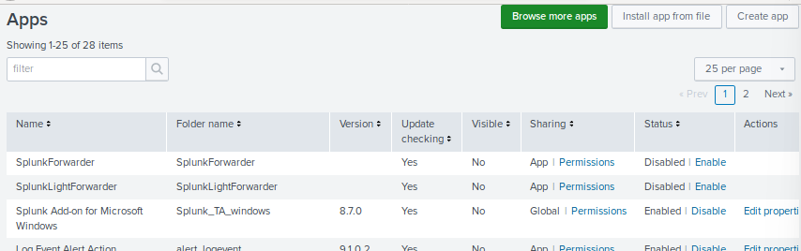
Splunk Add-on for Microsoft Windows

Slide 9
Logs Analyzed
Windows Logs
Apache Logs
1
2
The data that these Windows Logs contained includes intellectual property of VSI’s next-generation virtual-reality programs. They also include Windows Security Logs that represent the activity within the server. These actions can vary from normal everyday activity to some that are deemed unusual, including counts of success and failed logins as well as user accounts being deleted from the server.
The data that these Apache Logs contained includes information regarding the VSI’s main public-facing website, the URL being vsi-company.com. They also include Apache web server logs that represent the activity within the server. These actions include different HTTP methods (GET, POST, and HEAD), the count of each HTTP response code, and the domains that refer to VSI’s website.

Slide 10
Windows Logs
‹#›

Slide 11
Reports—Windows
Designed the following reports:
Report Name | Report Description
Table of Signatures and Associated Signature IDs | This report describes the actions of users with their corresponding ‘signature_id’ assigned to the action
Security Levels & Count/Percentage of Each | This report describes the severity of the security threat, how many times that threat has occurred, and the percentage of the threat to the total number of attacks
Comparison between Success & Failure of Windows Activites | This report describes the successes and failures of the activities that the users were able, or not able to perform

Slide 12
Alerts—Windows
Designed the following alerts:
Alert Name | Alert Description | Alert Baseline | Alert Threshold
Suspicious Activity Alert, Failed Logons | When there is a failed logon attempt, an alert will be triggered to SOC@VSI-company.com when the number of results is greater than 15 | Alert Baseline is 10 | Alert Threshold is 15
JUSTIFICATION: Analyzing the data we found in the Windows server log, we saw that the most failed logon attempts reached 10. We chose 15 to be the number of max failed logons before being considered as suspicious.

Slide 13
Alerts—Windows
Designed the following alerts:
Alert Name | Alert Description | Alert Baseline | Alert Threshold
Successfully logged on accounts | When an account was successfully logged in, an alert will be triggered to SOC@VSI-company.com when the number of results is greater than 20 within the hour | Alert Baseline is 15 | Alert Threshold is 20
JUSTIFICATION: We have decided that successful logged in attempts within one hour should be set to 15. If this number reaches 20 or over, then the SOC team should be notified.

Slide 14
Alerts—Windows
Designed the following alerts:
Alert Name | Alert Description | Alert Baseline | Alert Threshold
A User Account was Deleted | When a user account is deleted, an alert will be triggered to SOC@VSI-company.com when the number of results is greater than 45 | Alert Baseline is 30 | Alert Threshold is 45
JUSTIFICATION: What the current data shows is that the average number of user accounts being deleted hovered around 30-40. We feel that if the number of accounts deleted reached 45 or above, an alert should be triggered.

Slide 15
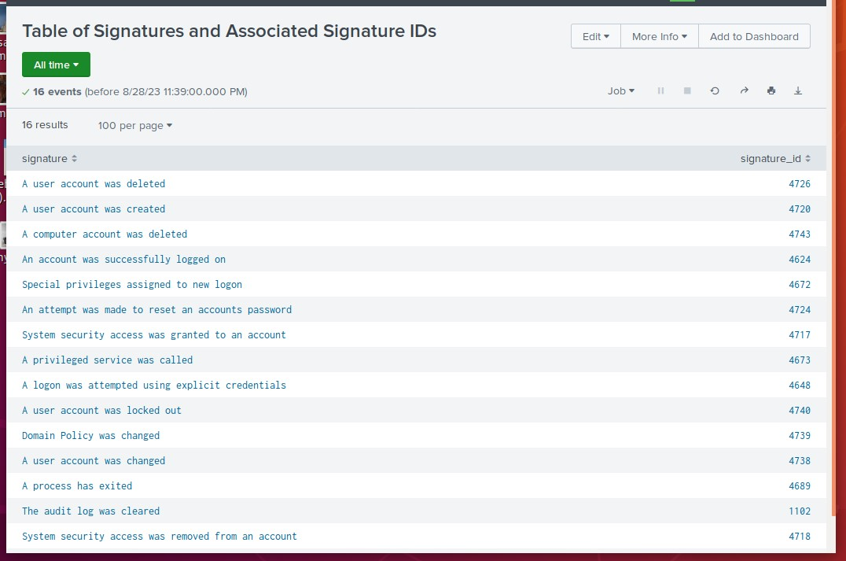
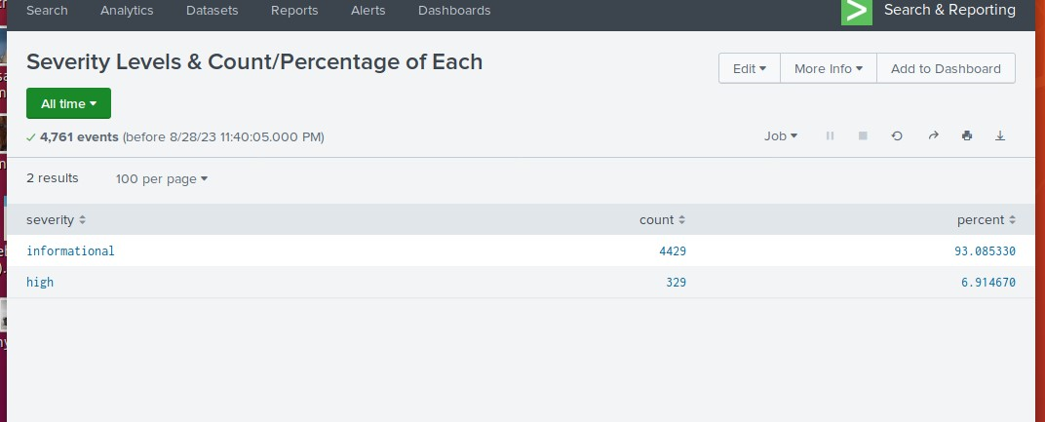
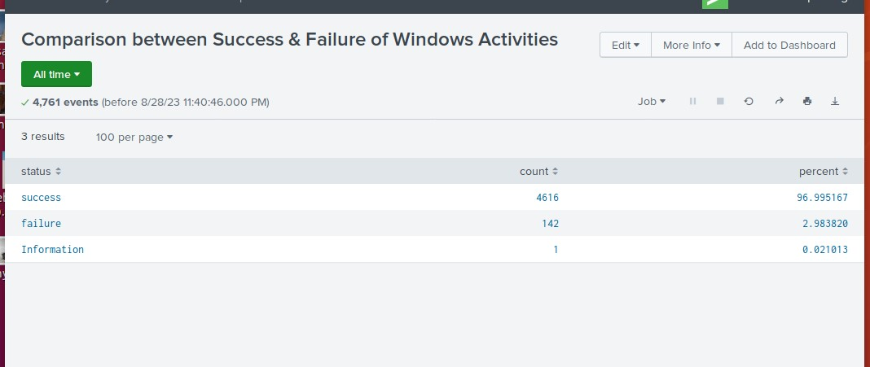
Images of Reports—Windows
Report Image
Report Image

Slide 16
Apache Logs
‹#›

Slide 17
Reports—Apache
Designed the following reports:
Report Name | Report Description
Different HTTP activity | Illustrating the count/percentage of each HTTP method
Domains referring to VSI’s website | Shows the websites that are referring to VSI’s website. Helps determine potential malicious actors
Count of each HTTP response code | Allows us to view the HTTP response codes and any potential “suspicious” levels in the volume of codes

Slide 18
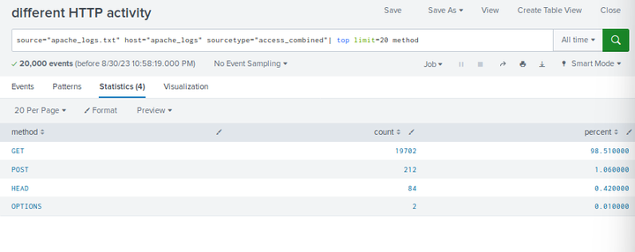
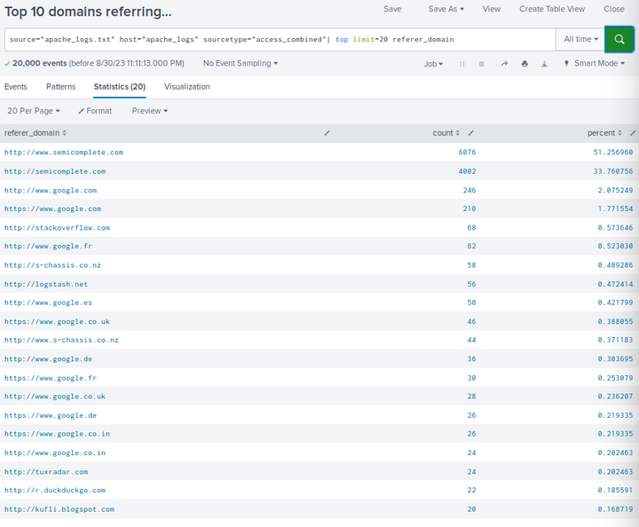
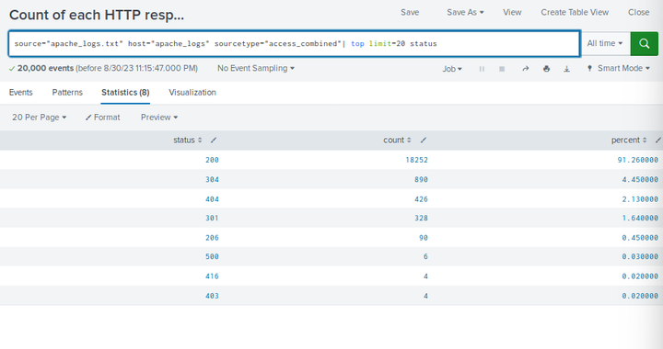
Images of Reports—Apache
Report Image
Report Image

Slide 19
Alerts—Apache
Designed the following alerts:
Alert Name | Alert Description | Alert Baseline | Alert Threshold
Non-US Activity | An alert for the amount of international activity within an hour on VSI’s website. An email will be sent if threshold is triggered. | 90 | 118
JUSTIFICATION: While examining the Non-US Activity report, we discovered where a majority of the events per hour were between ~75-110. The max number of events was 120, so we figured 118 was a nice commonground.

Slide 20
Alerts—Apache
Designed the following alerts:
Alert Name | Alert Description | Alert Baseline | Alert Threshold
HTTP POST Method Alert | An alert in regards to the amount of HTTP POST methods sent to VSI’s website within an hour. An email will be sent if the threshold is met. | ~7 | 10
JUSTIFICATION: With the exception of two hours, the rest of the hourly HTTP POST events were less than 10. We figured this was a good threshold to set, but could possibly need to raise it if overreporting becomes a problem.

Slide 21
Attack Analysis
‹#›

Slide 22
Attack Summary—Windows
Summarize your findings from your reports when analyzing the attack logs.
Our first report consisted of suspicious changes in severity. We found that the greatest change was that the High severity, which increased from 6.91% to 20.23%, which would suggest suspicious activity.
Our second report was on changes in failed activities, this showed us that failed activities went down from 2.98% to 1.56%, we did not consider this enough to be suspicious at that point.

Slide 23
Attack Summary—Windows
Summarize your findings from your alerts when analyzing the attack logs. Were the thresholds correct?
Alert analysis for failed Windows activity resulted in suspicious activity, a possible brute force. Alert would have been triggered on the hourly report that consisted of 35 counts.
Alert analysis for successful logins consisted of suspicious activity. One hourly report consisted of 1,293 logins, the main user being User_k with 1,256 logins in that hour.
Alert analysis for deleted accounts resulted in suspicious volume. There was a significant drop in deleted accounts each hour. This suggests that Admins may not be deleting accounts of ex-employees or transferees, this raises concerns, but further investigation is required to confirm suspicious activity.
All thresholds met the standard and served their initial purpose as intended. We will continue to re-evaluate as necessary.

Slide 24
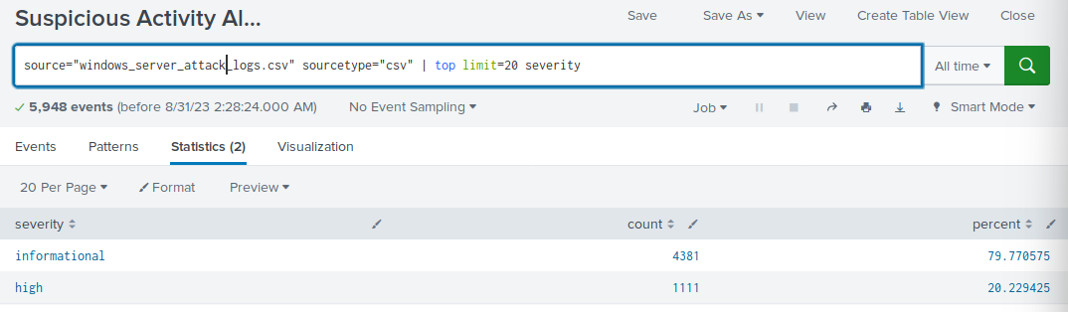
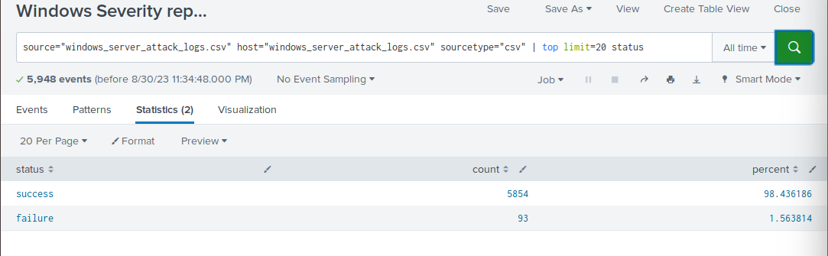
Screenshots of Attack Logs: Reports
Suspicious changes to High severity in Attack Logs.
Non suspicious changes in failed activities.

Slide 25
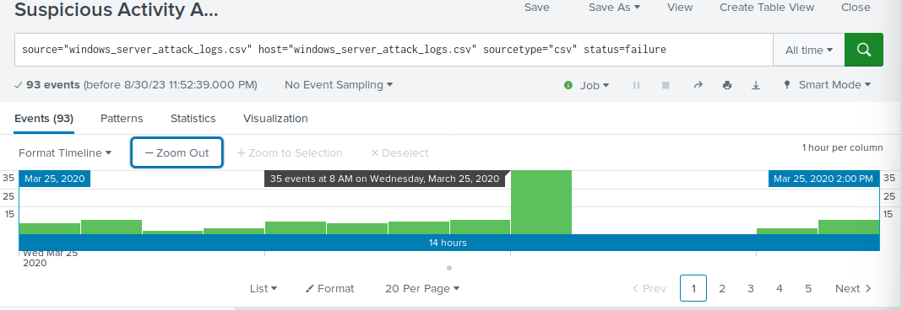
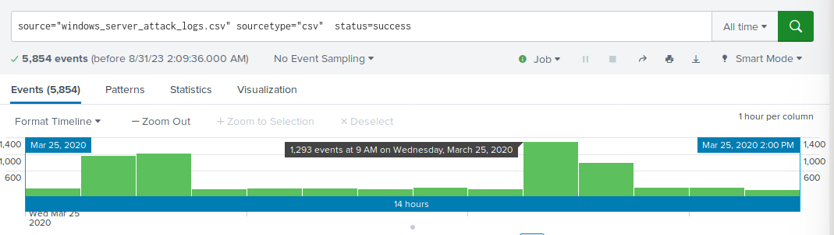
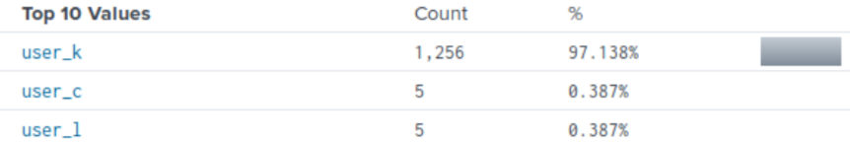
Screenshots of Attack Logs: Alerts
Alert analysis for failed Windows activity resulted in suspicious activity, possible brute force attack.
Successful logins consisted of suspicious activity, along with highest logins within an hour and by who.

Slide 26
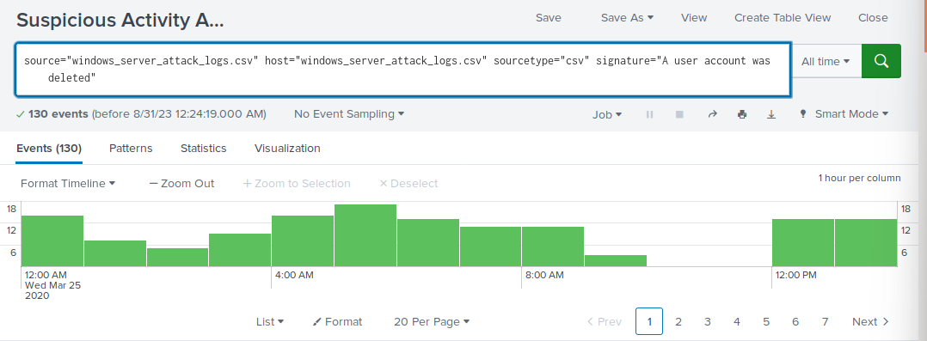
Screenshots of Attack Logs: Alerts…Continued
Overall decrease in deleted accounts resulted in suspiciously low volume.

Slide 27
Attack Summary—Apache
Summarize your findings from your reports when analyzing the attack logs.
HTTP Methods Report
GET Requests falling dramatically from 19,000+ to ~3,100
POST Requests increasing substantially from 212 to 1,324
Referrer Domains Report
All traffic decreased substantially from the thousands to simply the hundreds
Possible DDOS/Brute Force attack
HTTP Response Codes Report
Number of overall response codes decreased mirroring the Referrer Domains Report
Possible DDOS/Brute Force attack

Slide 28
Attack Summary—Apache
Summarize your findings from your alerts when analyzing the attack logs. Were the thresholds correct?
Non-US Activity Alert
Very suspicious activity occurred on 03/25/2020 at 8pm with over 900 international events logged within an hour.
Our threshold of 118 would have been triggered, but could be a tad low overall. There was only one other hour that logged more than 118, so we doubt over reporting should be an issue.

Slide 29
Attack Summary—Apache…Continued
Summarize your findings from your alerts when analyzing the attack logs. Were the thresholds correct?
HTTP Post Method Alert
Suspicious activity occurred on 03/25/2020 at 8pm with exactly 1,296 POST Method requests logged within the hour.
Our alert would be triggered since our threshold was 10. If anything, our threshold should be increased due to the large disparity if overreporting becomes a problem.

Slide 30
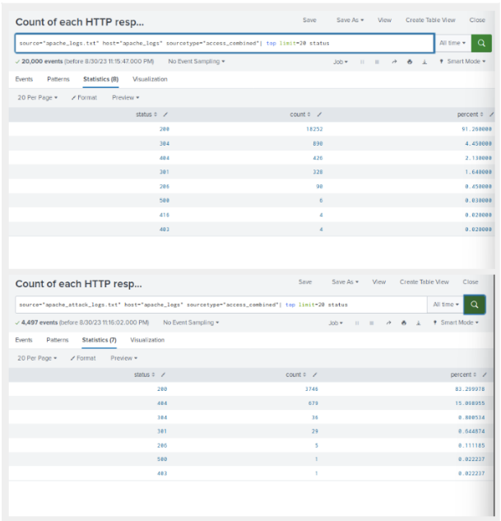
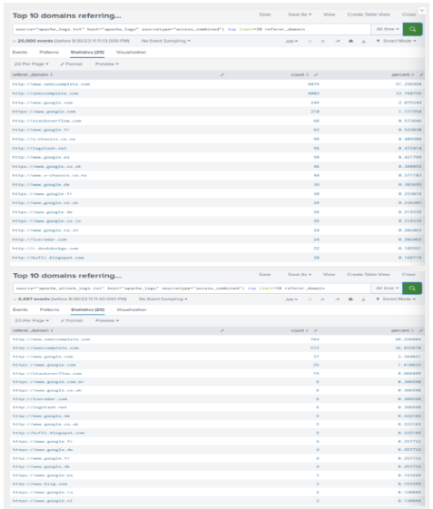
Screenshots of Apache Attack Logs
Decrease in HTTP response codes
Decrease in web traffic to VSI’s website

Slide 31
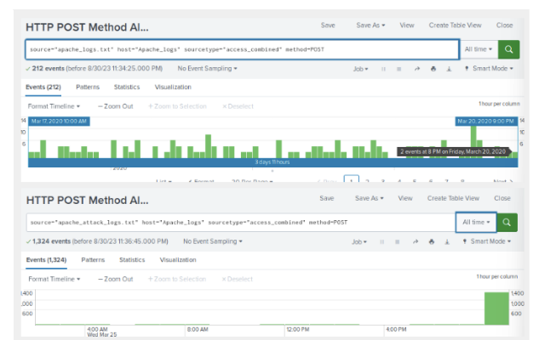
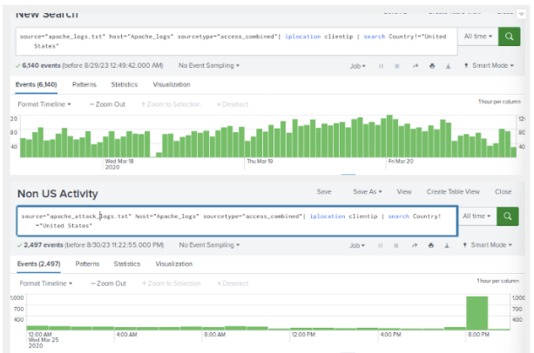
Screenshots of Apache Attack Logs…Continued
Spike in HTTP POST Requests before and after attack
Spike in Non-US Activity before and after attack

Slide 32
Summary and Future Mitigations
‹#›

Slide 33
Project 3 Summary
What were your overall findings from the attack that took place?
We have concluded that the overall attack was potentially a DDOS or Brute Force attack.
All of our alerts and thresholds were able to catch the suspicious activity to alert the SOC team. Overreporting could be potential issue down the line with some of our thresholds being a little low.
Mitigations for Future Attacks:
Enforce stronger user authentication
Have employees created stronger passwords more regularly
Utilize encryption methods
Use encryption protocols (TLS/SSL) for data transmitted over networks
Perform regular security assessments
Conduct regular security testing exercises (i.e. penetration testing)

